Slide 1
CUSTOMER CHURN PREDICTION
Name: Ankita
Roll no: 12300258
Stream: B.tech CSE

Slide 2

CERTIFICATION :”ISO 9001:2015/ISO 27001 CERIFIED.”
Specializations:
-web Development
-Mobile Application Development
-UI/UX Design
-QA & Software testing
-Cloud Solutions
-Data Analytics & BI
Company
Profile
Headquarters:Mohali,punjab
Branch Office: Chandigarh

Slide 3
Company Name: Sensation software solutions Founded: 2013
Certification: ISO 9001:2015 Certified Specializations:
Mobile Development
Web Development
Software Development
Digital Marketing
IT Integration
Experience: Over 12 years
Company Profile

Slide 4
Table of Content
Company Overview
Founding & Incorporation Details
Experience & Years in Industry
Specialization Areas
Core Services Offered
5.1 Web & Software Development
5.2 Mobile App Development
5.3 E-Commerce Development
5.4 UI/UX Design
5.5 QA & Software Testing
5.6 Digital Marketing Services
5.7 Software Consulting & Support
5.8 Training & Internship Programs
Industries Served

Slide 5

INTRODUCTION
Sensation Software Solutions Pvt. Ltd. is a leading IT and software development company established in 2013 and headquartered in Mohali, Punjab, India. With over 12 years of experience, the company specializes in delivering customized digital solutions that help businesses grow, innovate, and build a strong online presence..

Slide 6





TECH USED
Python
JUPYTER LAB
Python being an object-oriented programming language. It has a very easy syntax despite being case-sensitive and interpreted. Indentation increases readability.
JupyterLab is an advanced, web-based interface for working with Jupyter Notebooks. It supports code, text, terminals, and data visualization in a flexible, multi-tab layout—ideal for data science and research.

Slide 7


PYTHON LIBRARIES
Pandas is a powerful open-source Python library used for data manipulation and analysis. It provides data structures like DataFrames and Series, making it easy to clean, filter, and transform structured data efficiently.
NumPy is a fundamental Python library for numerical computing. It supports multi-dimensional arrays and provides a wide range of mathematical, statistical, and linear algebra operations, making it ideal for scientific computing.

Slide 8


Matplotlib is a Python plotting library used for creating static, interactive, and animated visualizations. It gives users full control over figure styling and layout, and it's commonly used to create line, bar, and scatter plots.
Streamlit is a Python library for building interactive web applications, especially for data science and machine learning projects. It allows quick creation of user-friendly interfaces using simple code and integrates seamlessly with Python libraries for real-time visualizations and interactions.

Slide 9

Seaborn is a data visualization library built on top of Matplotlib. It simplifies complex visualizations with minimal code and is especially effective for statistical plots like heatmaps, boxplots, and distribution charts.

Slide 10
Goals and Objectives
Sales Analysis:
Sensation Solutions operates in the IT services and training sector. Its sales revenue primarily comes from:
Dashboard Development:
Dashboard development involves creating a centralized platform that displays important information using:
Charts
Graphs
KPIs (Key Performance Indicators)
Tables
Real-time data feeds
Alerts & notifications
.
Revenue Visualization:
Use Python libraries like Matplotlib and Seaborn to visualize revenue trends.
Business Decision Support:
Provide actionable insights to help businesses improve product strategies.

Slide 11
Data flow diagram
+-------------------------+
| Customer / Client |
+-----------+-------------+
|
| 1. Project Requirements
v
+--------------------------------------------------------------+
| SENSATION SOFTWARE SOLUTIONS |
|--------------------------------------------------------------|
| 1. Sales & Marketing System |
| 2. Project Development System |
| 3. Finance & Billing System |
| 4. Reporting & Analytics System |
+-----------------+------------------+--------------------------+
| | |
2. Proposal & Estimate | |
v | |
+------+ | |
| Sales Team | | |
+------+----+ | |
| 3. Project Approval |
v |
+-----------+ |
| Projects | 4. Payment Data |
+-----------+------------------------------+
|
v
+----------------------+
| Finance System |
+----------+-----------+
|
| 5. Revenue Reports
v
+---------------------+
| Management Team |
+---------------------+

Slide 12

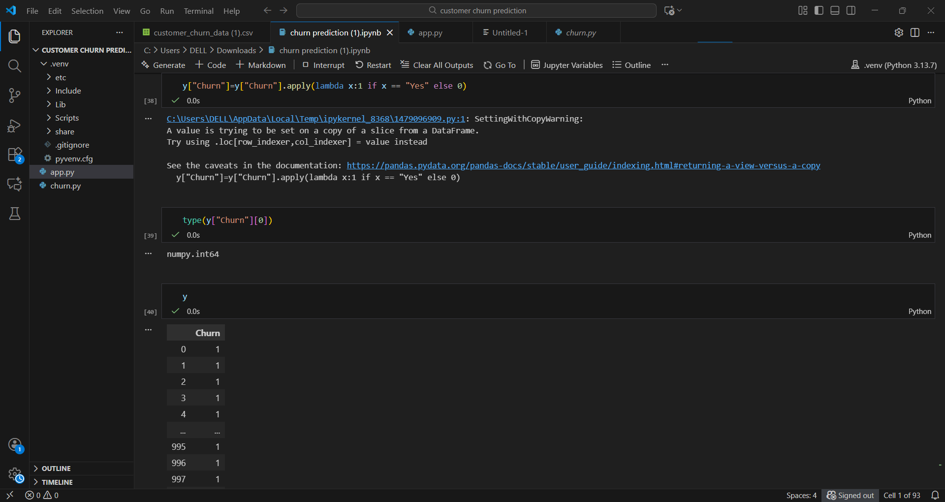
Screenshots

Slide 13

Conclusion
The Customer Churn Prediction model provides valuable insights into the factors that influence customer behavior and helps businesses identify customers who are at high risk of leaving. By analyzing customer demographics, usage patterns, service issues, and account information, the model can accurately predict churn and allow organizations to take proactive retention actions.
The results show that machine learning techniques such as Logistic Regression, Random Forest, or XGBoost can effectively classify churn and reveal the most significant drivers — such as contract type, monthly charges, service quality, and customer support interactions. With these insights, companies can design targeted marketing campaigns, offer personalized solutions, and improve customer experience.
Overall, the churn prediction system serves as a powerful decision-support tool that reduces customer loss, increases revenue, and strengthens long-term customer relationships. Implementing such a model enables businesses to become more data-driven, competitive, and customer-centric.

Slide 14

Future Scope
The future scope of customer churn prediction includes integrating real-time analytics, using advanced deep learning models for higher accuracy, and applying explainable AI to better understand churn factors. The system can be expanded to recommend personalized retention strategies, include sentiment data from social media, and integrate with CRM tools for automated action. Continuous learning models and interactive dashboards can further improve decision-making and help businesses reduce churn more effectively..

Slide 15
REFERENCE
https://www.kaggle.com/blastchar/telco-customer-churn
https://developer.ibm.com/articles/customer-churn-analysis/

Slide 16
THANK YOU!

